Slide 1
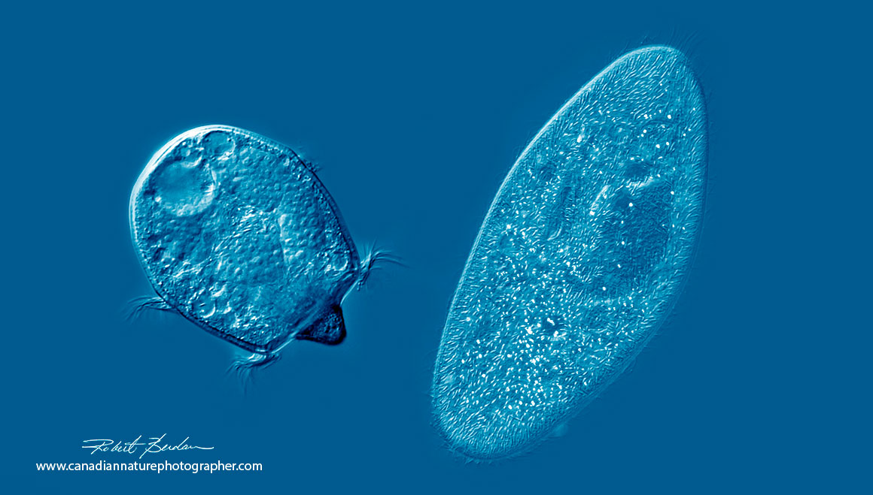
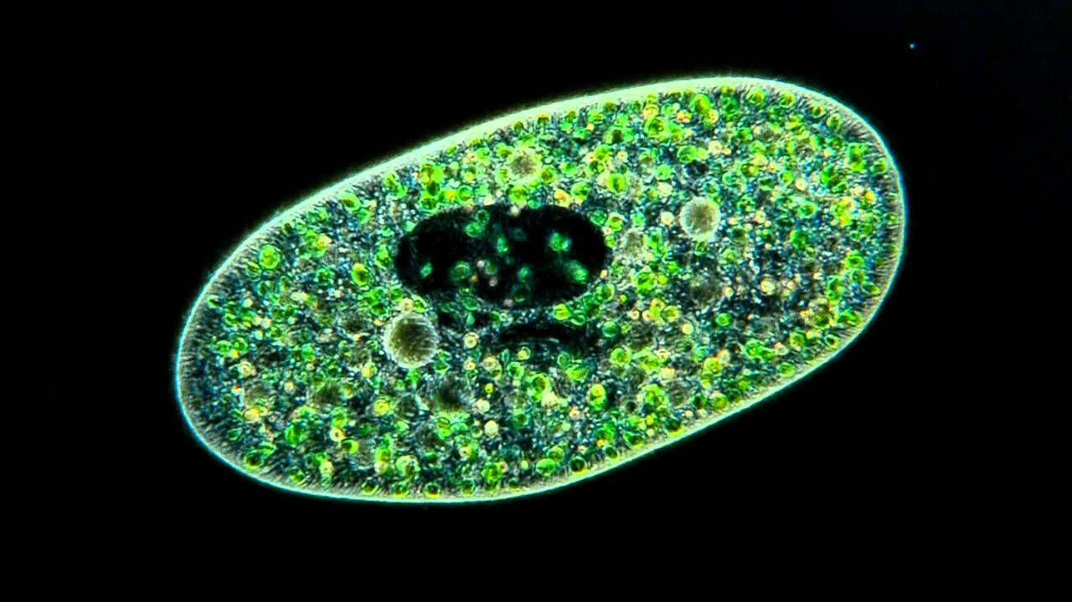

Qingqing Yang
School of Biological Sciences
Ecology, Evolution, and Behavior
Questions: By what mechanisms does temperature affect species interactions, population dynamics, and eco-evolutionary processes? How can math help describe these effects, and how can I use experiments to contribute to ecological theory?

Slide 2
